Slide 1
Making Friends With The Platform Cache
Notes:
Just short intro! Nothing ellse

Slide 2
Daniel Stange
Technical Architect
die.interaktiven GmbH & Co. KG
You can find me at @stangomat

Slide 3
Key Takeaways
Learn using the platform cache can boost your app‘s performance significantly
Understand which kind of data to put in the cache
Know the obstacles when you use to the platform cache and prepare for cache misses and unexpected results
Notes:
What to expect?
Intermediate Level Coding Sklills, Apex Devs

Slide 4
Platform Cache
GA since Winter 16
Simple Key-Value-Approach (Map<String, Object>)
Easy to implement ANY cache strategy
Not so easy to design a GOOD, sustainable strategy

Slide 5
Cache Types
ORG one cache for all users and contexts
longer TTL
SESSION
scoped per Session
TTL = Session length

Slide 6
First Steps
Create a cache partition (request a trial, if you‘re using a DE)

Slide 7
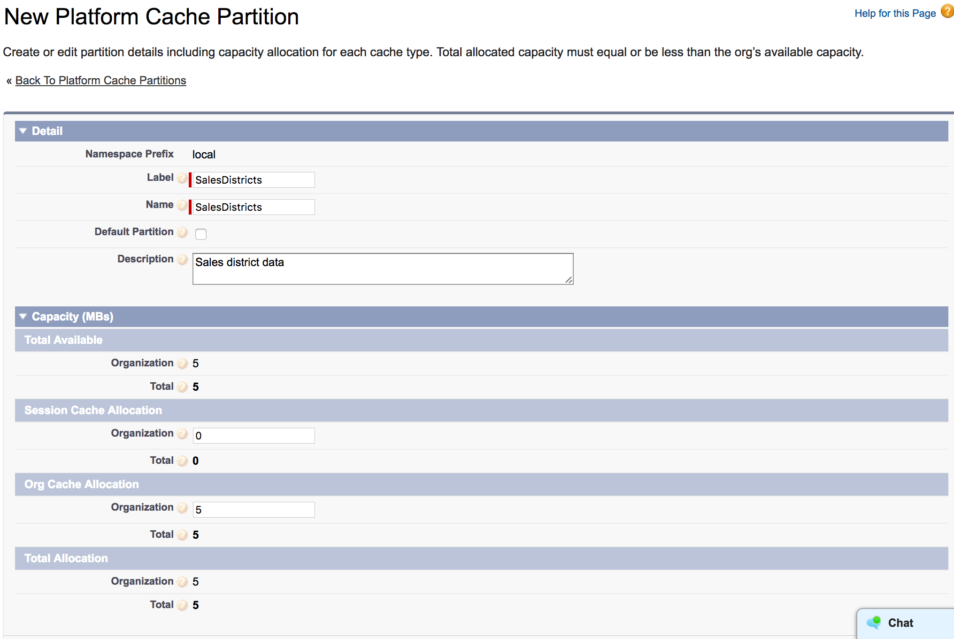
Place your screenshot here
Develop -> Platform Cache
Distribute some storage.
Cache partitions can be 0 or 5 to 10 MB in size

Slide 8
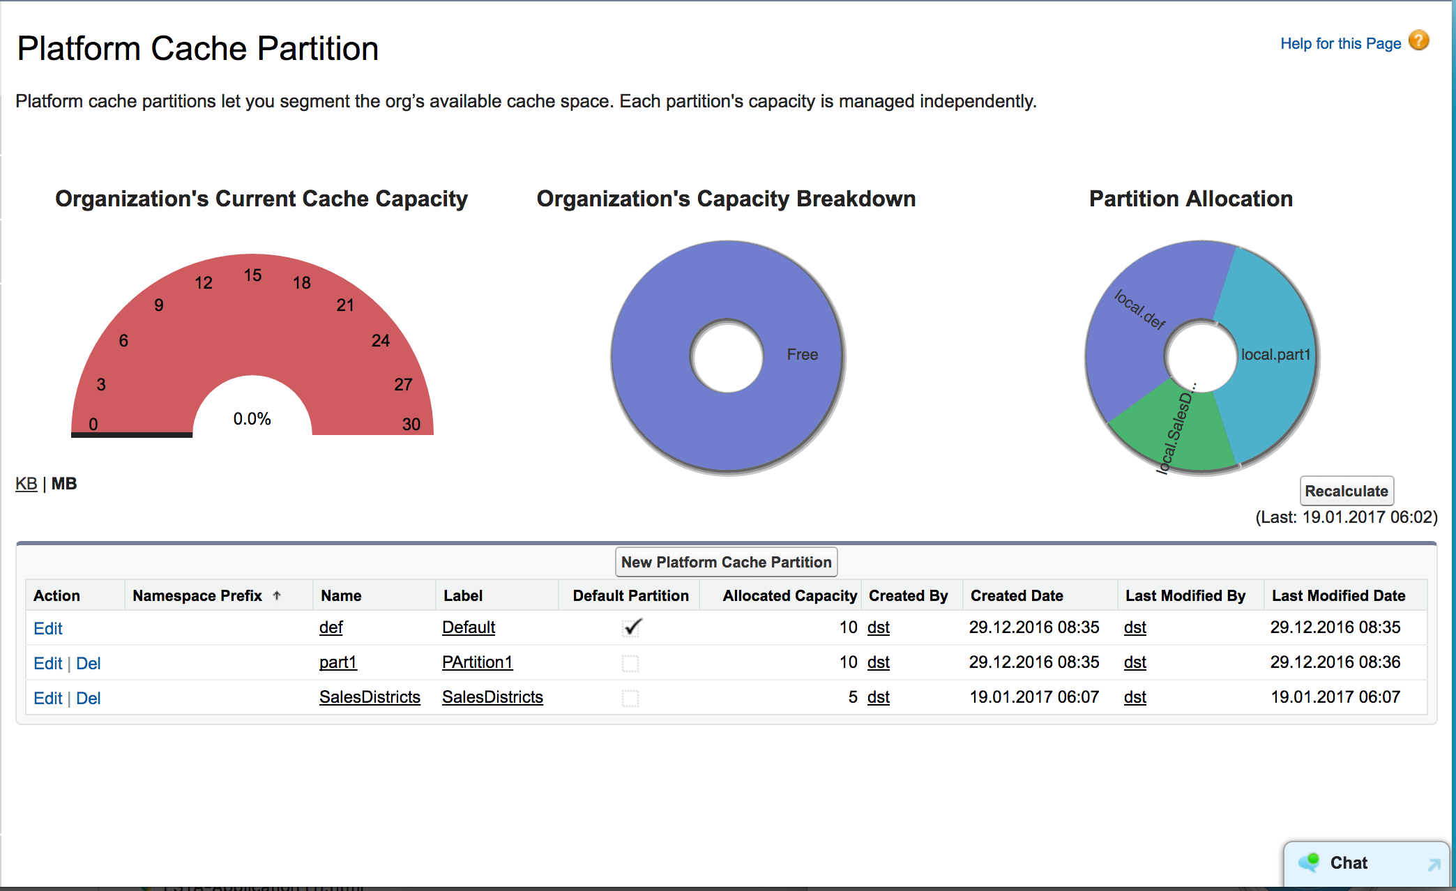
Place your screenshot here
Develop -> Platform Cache
Review your partitions

Slide 9
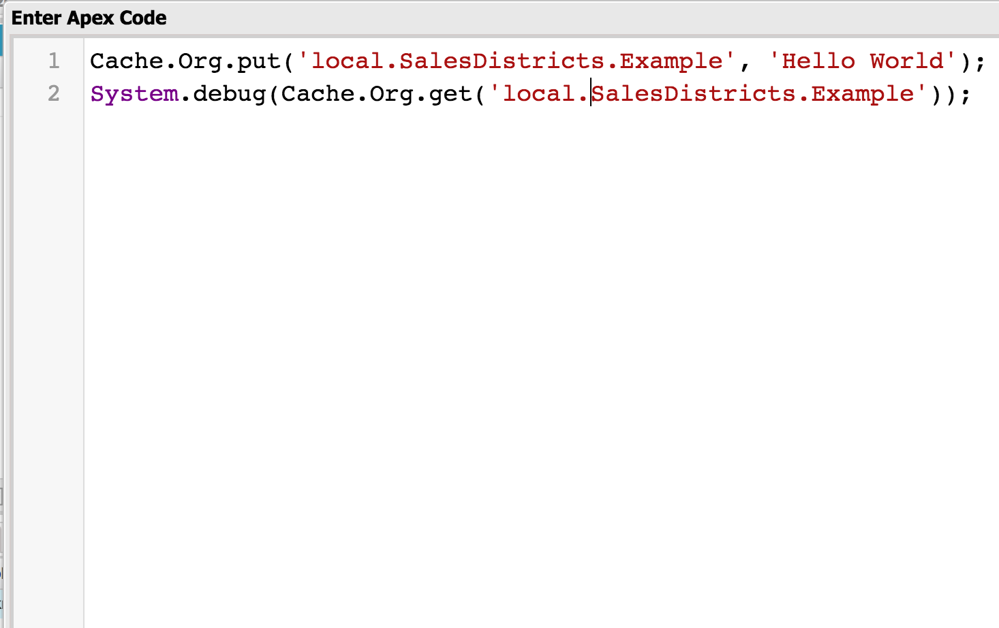
Place your screenshot here
Developer Workbench
Put in some data: Cache.[Org/Session].put(Namespace. PartionName.Key, Object)

Slide 10
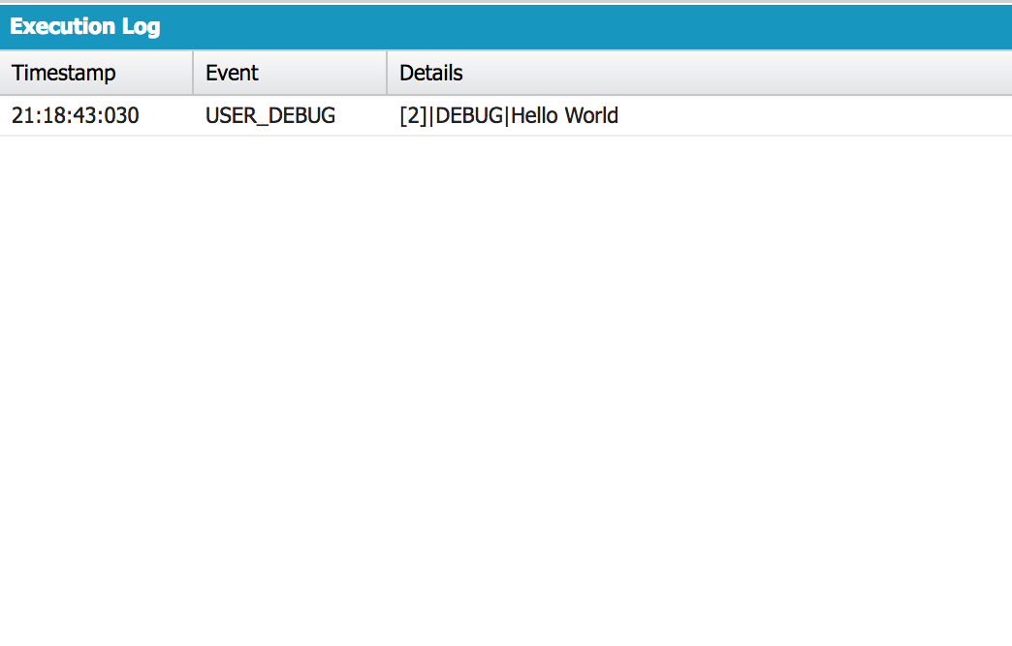
Place your screenshot here
Developer Workbench
Retrieve your first value

Slide 11
First Impressions
It works really smooth
It‘s like interacting with a map of Objects by calling put() and get() methods on it
... and it‘s super fast (compared to using SOQL to build maps)

Slide 12
155ms
5,5ms
28,8x
Average Time to fetch 9500 records as a Map<Id, Product2> through SOQL
Average time to fetch the same map of Product2 sObjects from the Org cache
Faster Access

Slide 13
Data to cache
PREPARABLE - REUSABLE
Data frequently needed in operations
Static data
Expensive to get (in terms of system limits)
Taxonomies, Schedules, Mappings, Conversion Rates, etc.

Slide 14
Nice! Easy! Fast! Where‘s the catch?
It‘s still a cache, not a database.
It is short lived
Understand the key concepts of the platform cache (in particular TTL, LRU)
Expect the cache to fail you.

Slide 15
Build your Strategies
The Cache will go away... Have a rebuild strategy
Cached items will be pushed out Have a fallback strategy
Cached items must adhere to the 100kB size limits Know what to cache and how to cache

Slide 16
Time-to-Live (TTL)
ORG: 5 min
MINIMUM TTL
SESSION: 5 min
ORG: 24 hrs
DEFAULT TTL
ORG: 48 hrs
MAXIMUM TTL
SESSION: 8 hrs

Slide 17
Cache Rebuild and Fallback
Use a CacheManager class
Schedule a cache rebuild
Trigger a rebuild when the cached objects change on disc
Wrap cache accessors in your own methods to catch misses and possible threads to your data
Use wrapper classes to reduce the overhead of cached sObjects

Slide 18
Size matters – 100kb equals
9k sObjects
12.5k wrapped items
Product2 records with ID, Name, ProductCode queried
Same query, using a wrapper class

Slide 19
Example / Demo
Accounts relate to SalesDistrict__c
SalesDistrict__c are assigned to Accounts by CountryCode and PostalCode
A default Sales District shall be used if no other can be found

Slide 20
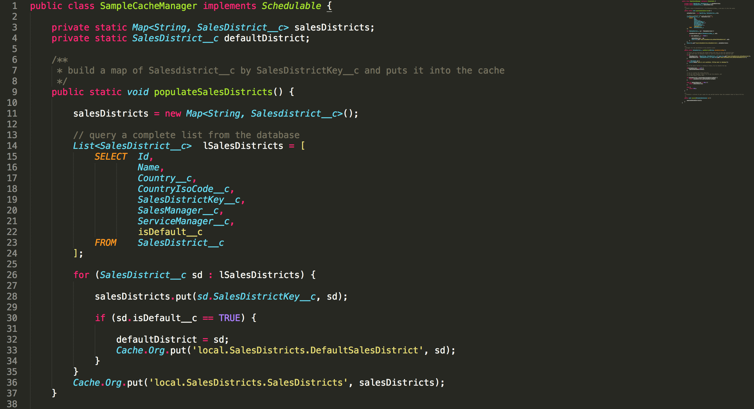

Slide 21
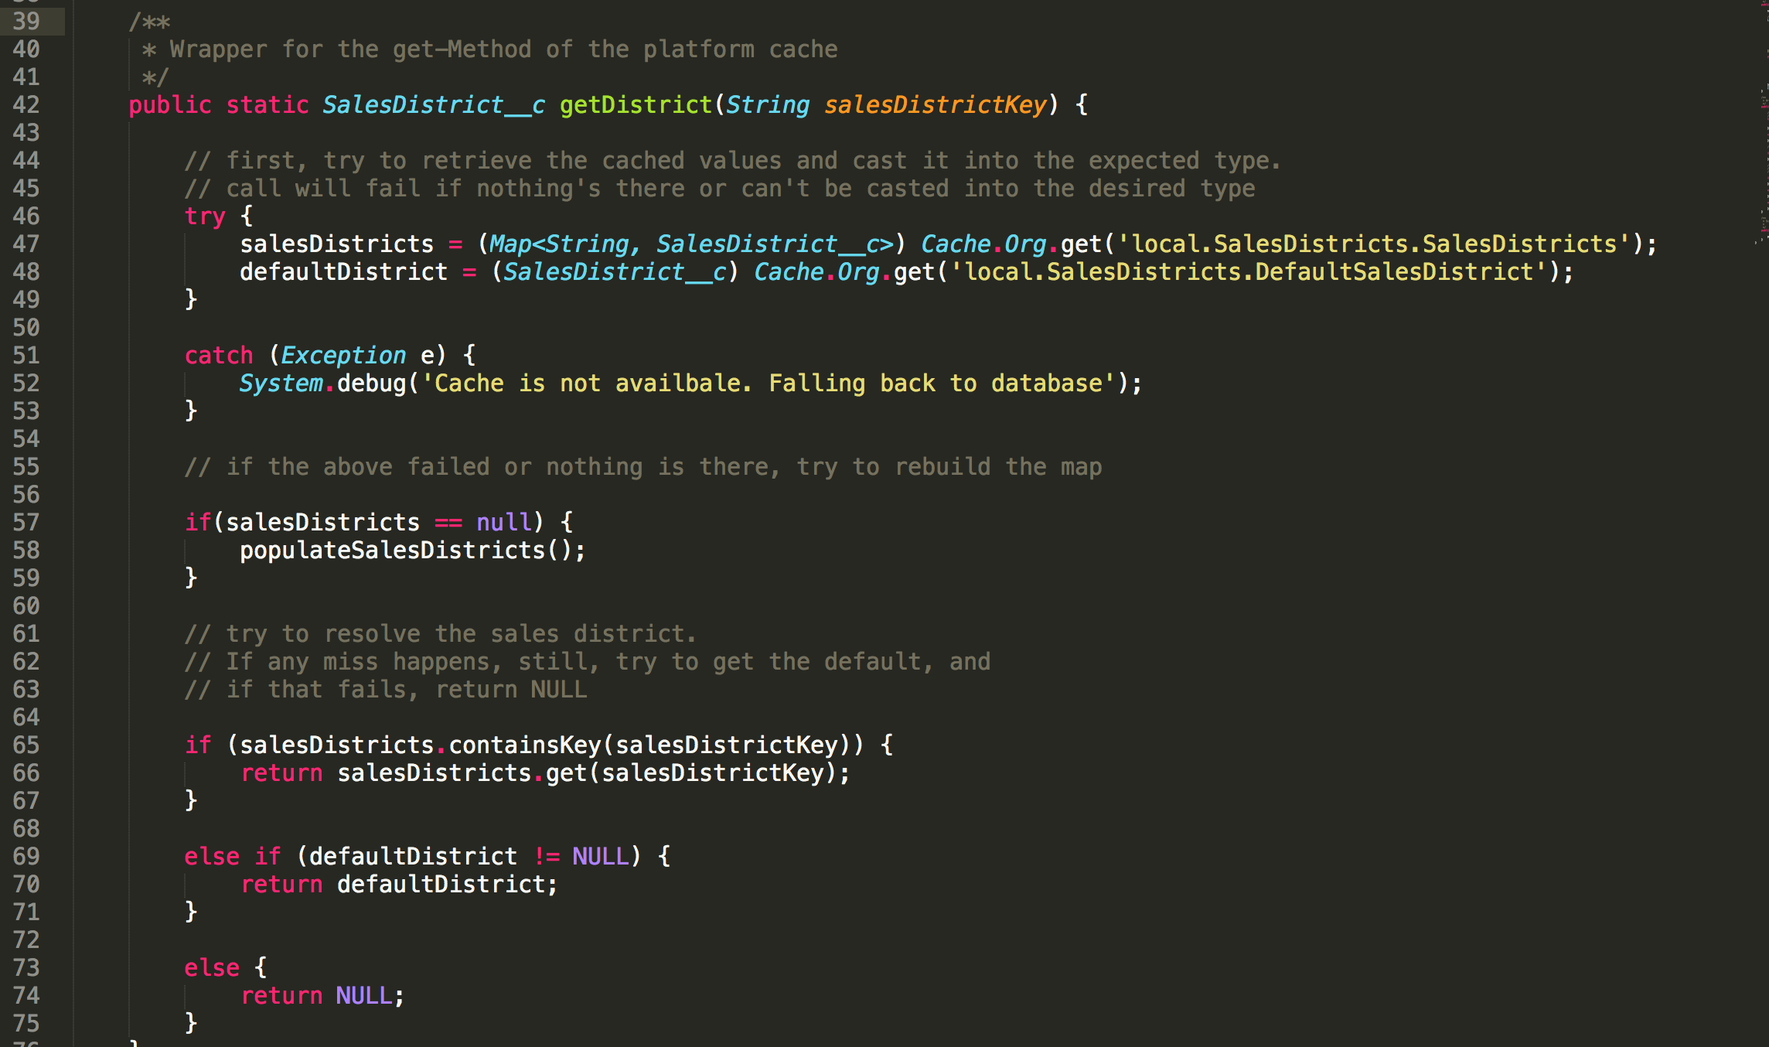

Slide 22
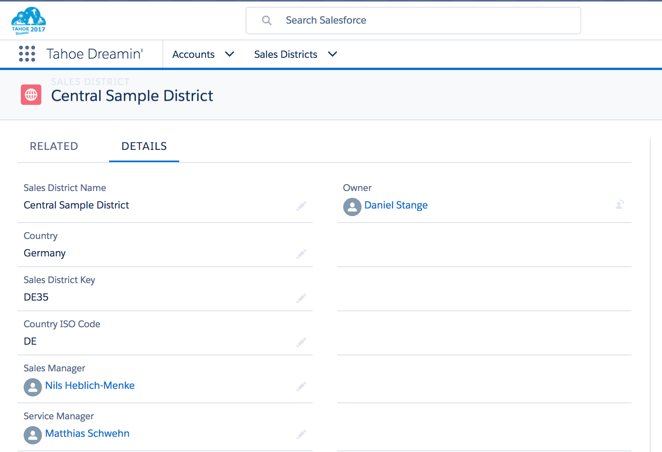
Place your screenshot here
Here‘s a Sample Sales District
Everything with Country = DE and PostalCode LIKE ‘45%’ should be assigned and have Nils as an Owner.

Slide 23
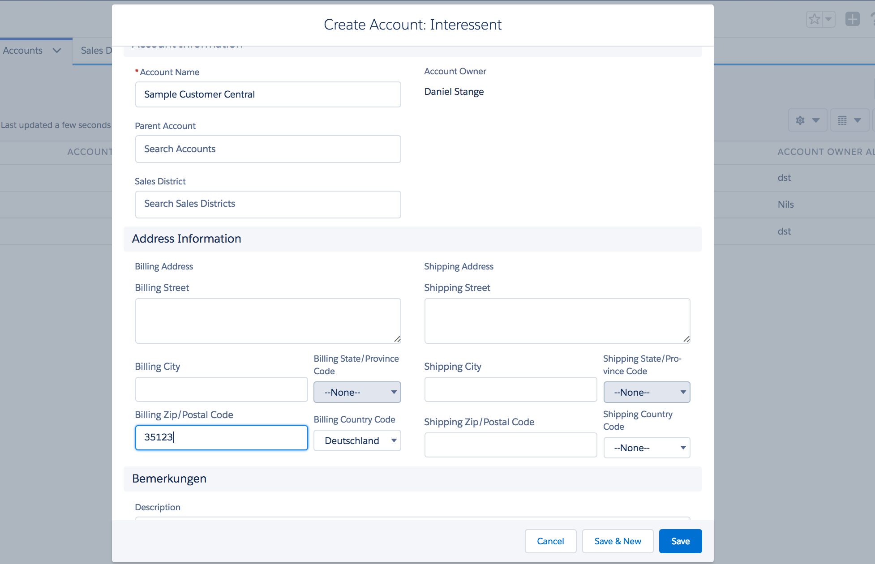
Place your screenshot here
Creating an Account
Postal Code starts with 35 and Country = DE
Should end up in Central Sample District being assigned

Slide 24
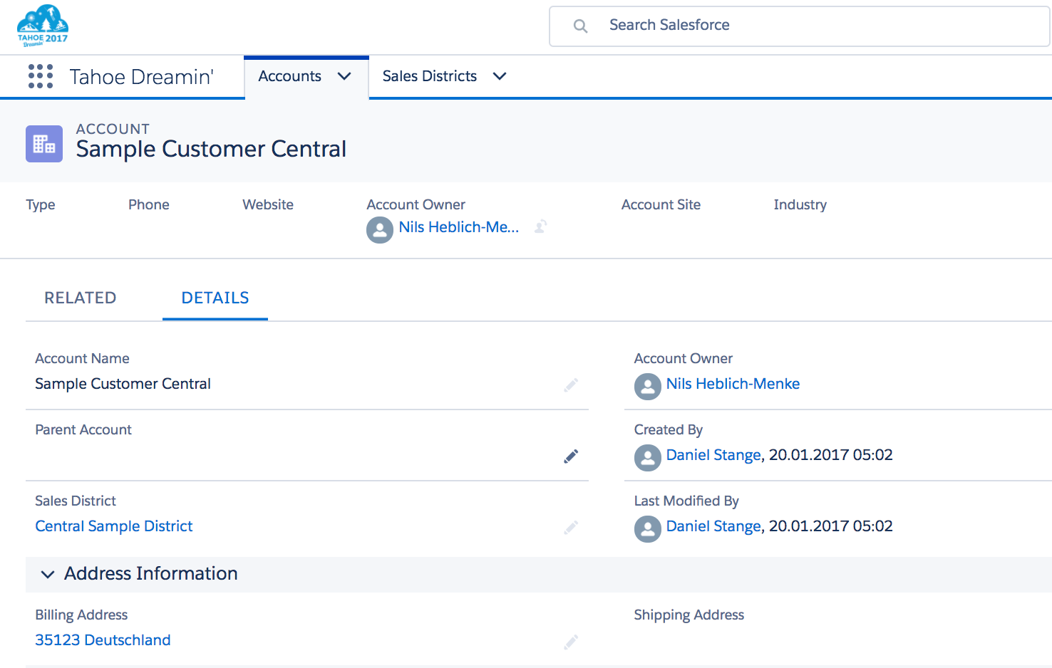
Place your screenshot here
And there it is!

Slide 25
Things to consider
Don‘t use the cache as a fast, limit-free database.
Don‘t use it as temporary storage for business objects
No items larger than 100kB
Cached Items are not persisted – don‘t rely on them being there.
Don‘t rely on cached items to be the same as those you put into the cache

Slide 26
Scheduled Job
Org.Cache.put (’Products’, List<Product2>{...});
Org.Cache-Default Partition
Products
User 1
Org.Cache.put(’Products‘, ‘Banana‘);
Why you shouldn’t trust the cache…
User 2 Org.Cache.put(‘Products’, some Map<Id, Product2>);

Slide 27
Best Practices
Usually, it‘s better to cache lists or maps of objects
Better performance of fewer, larger operations vs. 100kB item size limit
Use a wrapper class to reduce sObject overhead
Use the fully qualified name of your cache partition
Consider using the ‘immutable‘ flag
Again: Careful when storing business objects

Slide 28
Further Reading
Developer Documentation: bit.ly/cachedoc
Trailhead: Platform Cache Basics bit.ly/cachetrail
My Sample Code: github.com/dstdia/PlatformCache/
Keir Bowden’s blog post: bit.ly/cache-buzzard
Josh Kaplan‘s blog post: bit.ly/cache-sfblog
Amit Chaudhary: http://amitsalesforce.blogspot.com/2018/11/platform-cache-in-salesforce-platform.html

Slide 29
Thanks!
Any questions?
You can find me at:
@stangomat
Daniel.stange@die.interaktiven.de
Github.com/dstdia

